Slide 1
Charting Our Course:
An Overview of the Enrollment Projection Process at the College of Coastal Georgia
Dr. Jason Umfress
Vice President for Student Affairs & Enrollment Management

Slide 2
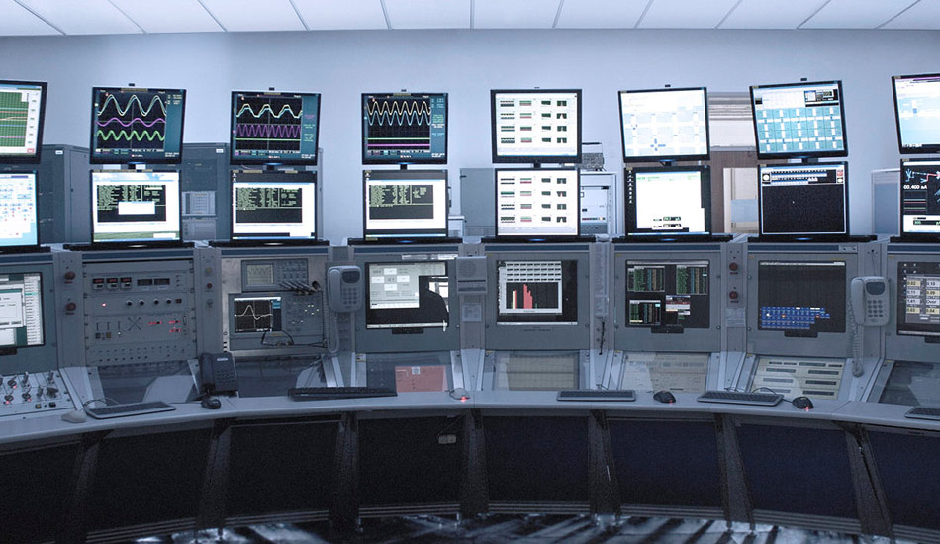
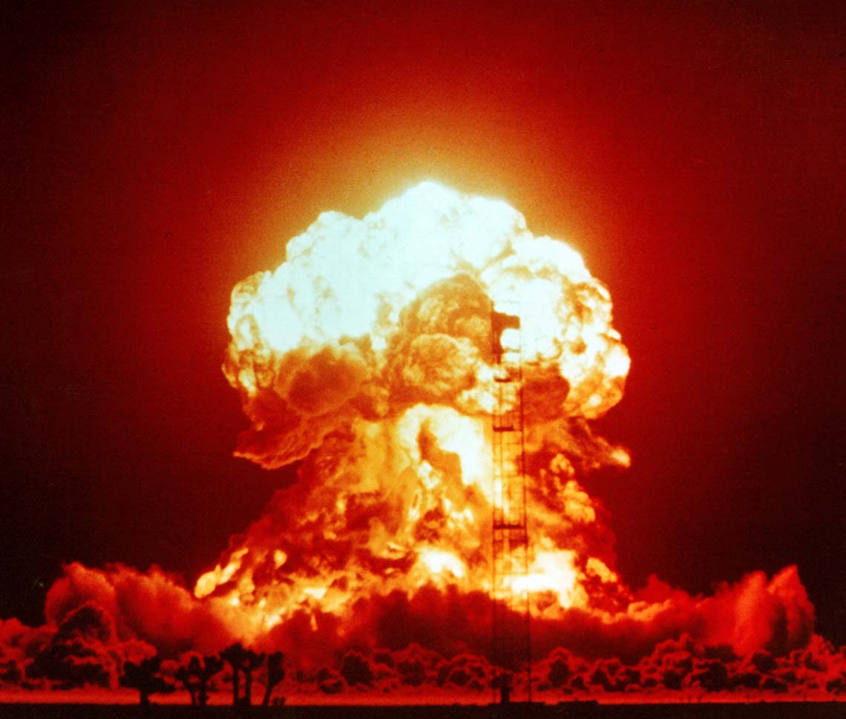
The COVID Impact…
Before…
AFTER…
Notes:
Susan

Slide 3




What’s special about our process?

Slide 4
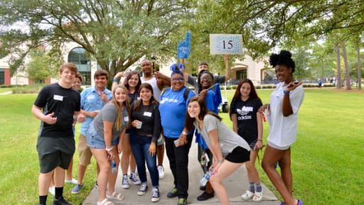
What’s special about our process?
Collaborative
  Multiple steps with lots of input
Transparent
  Invite the campus to peek into our process
Data-informed
  Combines the Science & Art of this work
“Home-grown”
  Projections are for us, by us!

Slide 5

Reality Check…
REALITY: Growth!
  New Freshmen
  Retention
  Transfer Students
  Readmits
  Dual Enrollment
  Everyone Else

Slide 6
Step 1: New Student Projections

Slide 7
Step 1: New Student Projections
How did we do?
What do we need to consider going forward?
Review of last 3 years…
  Apps/Admits/Enrolled per student type
  Apps/Admits/Enrolled per territory or…
  Apps/Admits/Enrolled per High School (feeder schools)
  Apps to Enrolled Yield Rates
  Accepts to Enrolled Yield Rates
Class Sizes / Grad Rates of Feeder High Schools
Accuracy of prior year projections
Vulnerable Populations
Policy Changes
Institutional Changes/Priorities
Competition Factors

Slide 8
Step 1: New Student Projections
Three goals (Differ based on metric):
What we set goals for…
Threshold - Baseline to make budget projections or realize slight growth (typically between 1% and 3%)
Target – “Appropriately aggressive” to realize movement in a population (Range: 3% - 8%)
Reach – “Significantly aggressive but attainable” to realize movement in a population (Range: 8%+)
Yield Rates
Total New Students
New Freshmen
  By Territory
New Transfer
Dual Enrollment
Readmits
Transient
Post-Bacs
Non-Degree

Slide 9
Step 2: Retention Projection Model

Slide 10
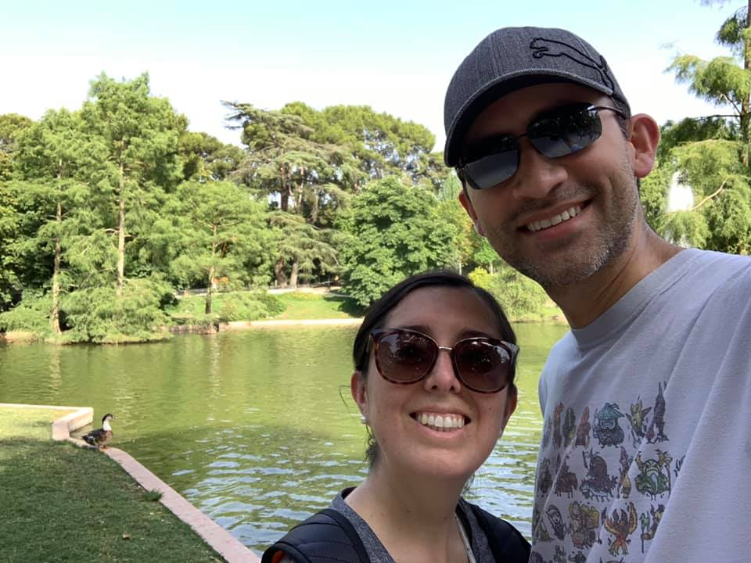
Step 2: Retention Projection Model
Developed by Dr. German Vargas & Dr. Diana Leal “for fun.”
Utilizes historical data from 2012 – 2022
Model is based on a weighted average of how “sure” we are to behave like 3 previous years (2020, 2021, 2022).
Tracks by class through the model, accounting for weighted average melt per year
Dual Enrollment, Transient, & Non-degree populations have been excluded from the model, but replaced in the final count.
The model is linear and assumes constant growth

Slide 11
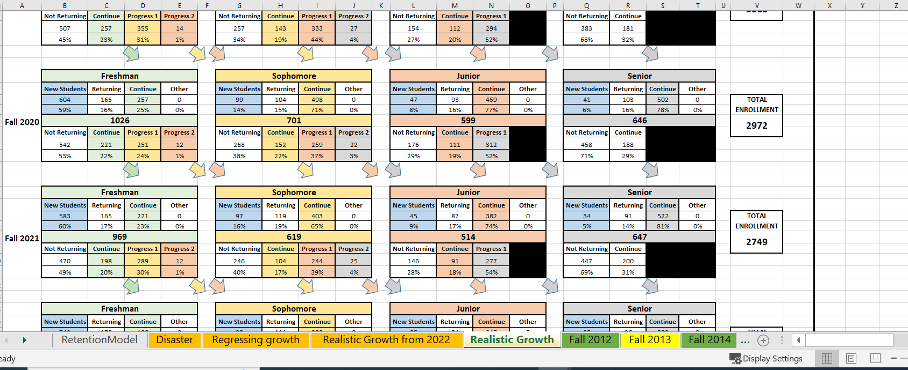

Slide 12
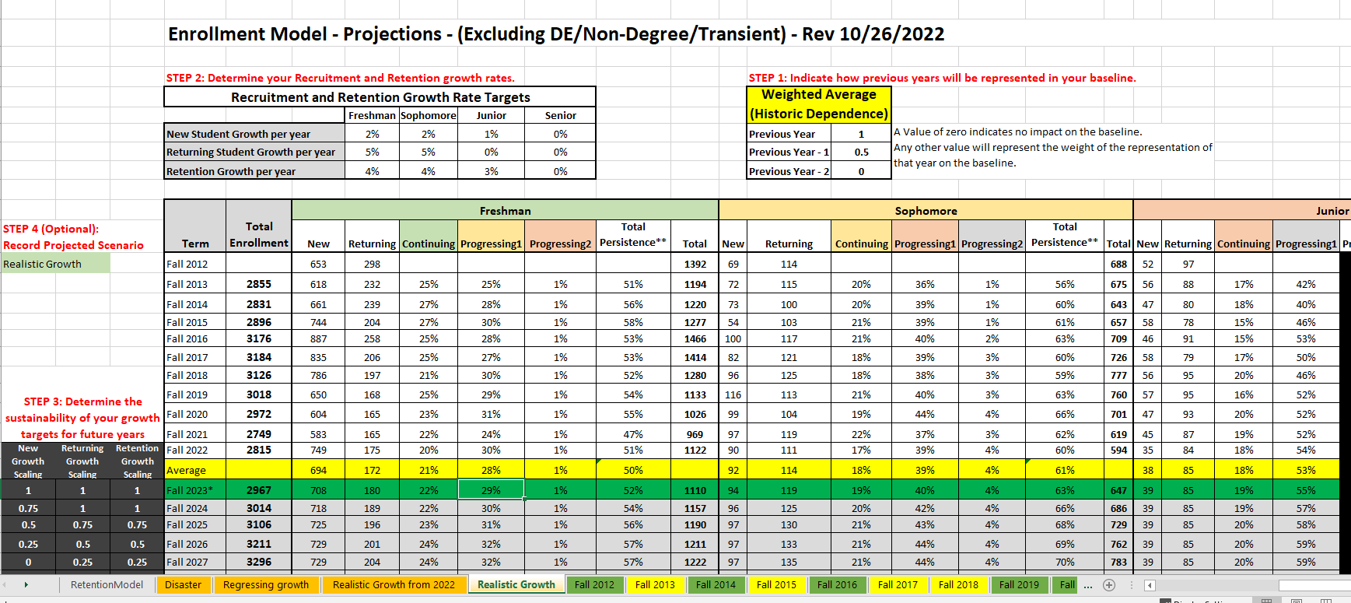

Slide 13
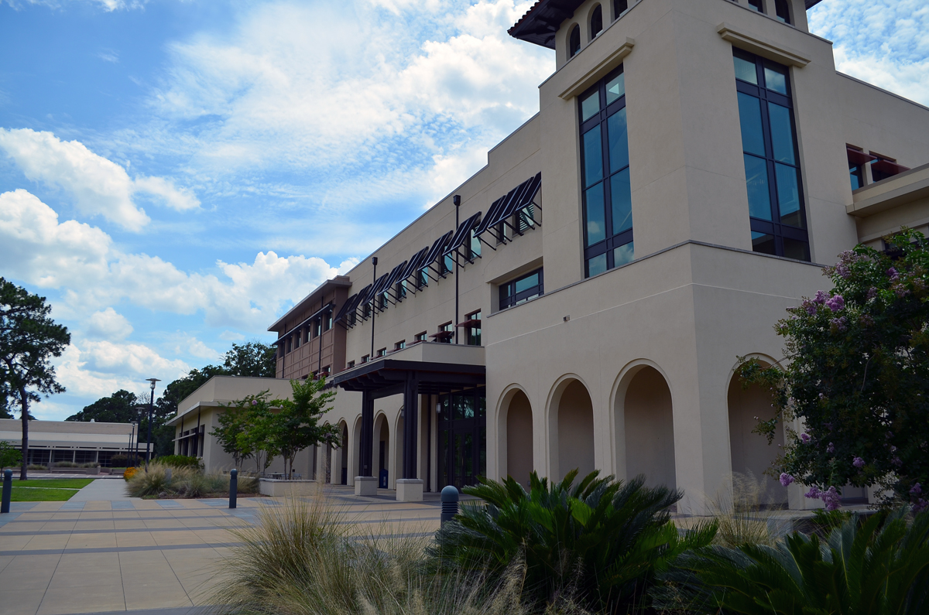
Step 2: Retention Projection Model
Typically Run 5 Scenarios
Flat
  Threshold + No Change in retention
Realistic Growth
  Target + 1%-3% improvement in retention
Aggressive Growth
  Reach + 4%-8% improvement in retention
Manageable Decline
  1%-3% decline in new and retention
Disaster
  “how bad does it have to be? “

Slide 14
How do we use this??
Manage expectations!
Visual representation of the importance and impact of retention!!!!
“What would it take?” conversations
Reiteration of “every student / every time” mantra
Build confidence & consensus on what we are doing to move the institution forward.

Slide 15


Slide 16
QUESTIONS? COMMENTS?

