Slide 1
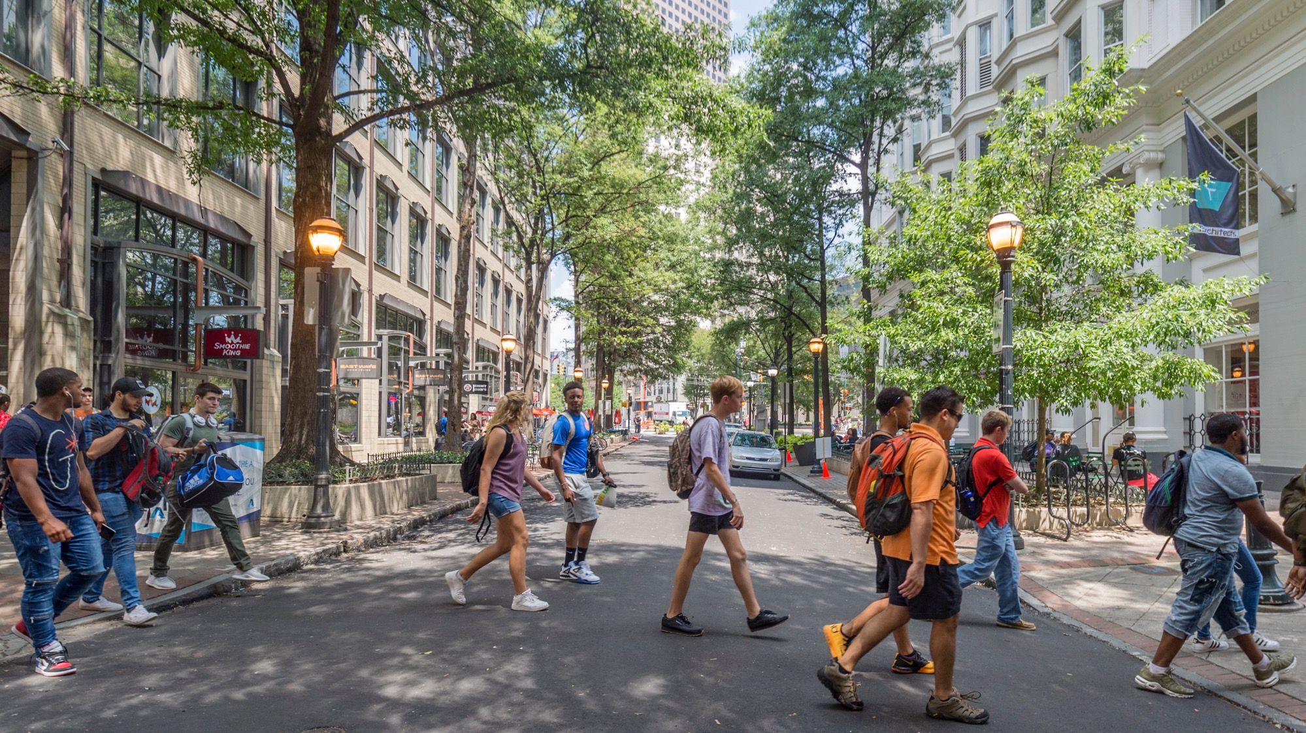

3/22/2023
Georgia State University Admissions Background Review Process

Slide 2
Review by the Office of Undergraduate Admissions and Graduate School
Applicants who respond “yes” to any of the Admissions Background Questions of the application are reviewed for admissibility
Only admissible applicants complete the ABR process
The determination of whether the applicant is reviewed by the ABR committee is based on the severity and nature of the reported information, and the level of threat to the campus
Notes:
Slide 2
Applicants who respond "yes" to any of the personal information section questions of the application are reviewed for admissibility. Only admissible applicants complete the admission background review (ABR) process. The determination of whether the applicant is reviewed by the ABR committee is based on the severity and nature of the reported information and the level of threat to the campus.

Slide 3
Admissions Background Review Committee
Planning Group was convened in 2008 by the Chair of Admissions and Standards a subcommittee of University Senate
Planning Process included various Administrative Offices
Committee members include a representative from the Registrar’s Office, Office of Admissions, Office of Legal Affairs, Office of the Dean of Students
Notes:
The ABR committee includes a representative from various administrative offices, including the Registrar's Office, Office of Admissions, Office of Legal Affairs, and the Office of the Dean of Students. The committee considers the applicant's disciplinary history, severity and nature of the offenses, recidivism, length of time since the offenses, and indication of rehabilitation before making their final decision.

Slide 4
ABR Committee Review Referrals
Admission Background Review Matrix: developed March 2022, enacted April 2022
Before March 2022; everyone answering “yes” to a question was reviewed.
Instances for an ABR referral include:
  Drug Distribution
  Assault with Deadly Weapons
  Felony Charges
  Sexual Misconduct
  Pending disciplinary/ academic proceeding
Notes:
Before March 2022, everyone who answered "yes" to a question was reviewed. However, after developing the Admission Background Review Matrix, only specific instances for an ABR referral are considered. These instances include drug distribution, assault with deadly weapons, felony charges, sexual misconduct, and pending disciplinary/ academic proceedings.

Slide 5
Differentiated Review Process
Process improvement was needed too many cases were being sent to the ABR Committee
Longitudinal data informed our decision-making process
Goals
Expedite the process for our applicants
Improve transparency
Notes:
Data informed the design of the process. We keep a longitudinal data record that includes any disciplinary or academic violations of students, even after they are admitted. This helps us keep track of the behavior of students and ensure that we maintain a safe and secure campus environment for everyone.

Slide 6
Admissions Background Review Matrix
Offices of Admission Undergraduate and Graduate | Admissions Background Review Committee
DUI Drug use Good Standing (except incidents of sexual misconduct) Theft Shoplifting Non felony charges | Drug Distribution Assault with Deadly Weapons Felony Charges Sexual Misconduct Pending disciplinary/ academic proceeding
Notes:
We used this data to inform our process. It showed students with offenses that fell on the right side were being approved by the committee. So, we created the differentiated process to move students through the process more quickly and to only have the committee review the more severe infractions.

Slide 7
Nature of What is Reported determines the follow-up
Personal statement required from all applicants
Criminal background check performed for violations of the law
  If in Georgia – is handled by the GSU Police department at no cost
  Out-of-State - is requested through PreCheck, a background screening company (cost)
FERPA Release and Request for Records for violations from high school or post secondary institution
Notes:
The nature of what is reported determines the follow-up. Everyone provides a personal statement, and if there is a violation of the law, a criminal background check is done. If in Georgia, it is done by GSU Police department at no cost; out-of-state background checks are done by PreCheck, a background screening company. If there is a violation from a high school or post-secondary institution, a FERPA release is required.

Slide 8
Criteria for Review
Whether in good disciplinary standing at the time of review
Factors considered include:
  Severity and nature of the offenses
  Recidivism
  Length of time since the offenses
  Indication of rehabilitation

Slide 9
Applicant self-disclosures review
Admissions Office: Admissions Counselor -Disciplinary Liaison, AVP of Admissions and Housing, Director of Undergraduate Admissions.
Office of the Dean of Students Office: Associate VP Student Engagement and Dean of Students, Associate Dean of Students and Senior Records Coordinator

Slide 10
Appeal Options
Undergraduate
Applicants for undergraduate admission who are denied for reasons related to disciplinary/criminal history or falsification of application may appeal the denial to the Senior Vice President for Student Success and Chief Enrollment Officer within twenty (20) calendar days of the date of the denial letter
The decision of the Senior Vice President for Student Success and Chief Enrollment Officer is final.
Graduate
Applicants for graduate admission who are denied for reasons related to disciplinary/criminal history or falsification of application may appeal the denial to the Dean of the Graduate School within twenty (20) calendar days of the date of the denial letter.
The decision of the Dean of the Graduate School is final.

Slide 11
Thank you
Contact Information:
Scott Burke
404 413-2088
sburke@gsu.edu

